Slide 1

ANALYSIS OF VEHICLE CO$2$ EMISSIONS A MACHINE LEARNING APPROACH PROJECT

Slide 2
ABSTRACT
This report presents a machine-learning project focused on analyzing vehicle CO2 emissions. The dataset used for analysis consists of various features such as Make, Model, Vehicle Class, Engine Size(L), Cylinders, Transmission, Fuel Type, Fuel Consumption City (L/100 km), Fuel Consumption Hwy (L/100 km), Fuel Consumption Comb (L/100 km), Fuel Consumption Comb (mpg), and CO2 Emissions (g/km). The objective of this project is to develop a predictive model to estimate CO2 emissions based on these features. The analysis aims to understand the impact of different vehicle characteristics on CO2 emissions and explore potential avenues for reducing emissions. With the increasing international consensus concerning the negative effects of climate change, reducing greenhouse gases has become a higher priority in government policies and research committees.

Slide 3
The transportation sector generates approximately 29% of the total greenhouse gas emissions and 25% of the global energy related carbon dioxide (CO2) emissions. Based on this review, one can conclude that selecting different measurements will significantly influence the assessment of the vehicle emission results and the applicable scope of the measurements. Considering the different influencing factors of the operating vehicle emissions will have an impact on the model application of the vehicle emission evaluation.

Slide 4
INTRODUCTION
The purpose of the CO2 emissions prediction ML project is to reduce carbon dioxide (CO2) emissions from vehicles by developing a machine learning model that can accurately estimate emissions based on vehicle characteristics. The project aims to achieve the following objectives:
Data Collection: Gather a comprehensive dataset that includes relevant vehicle characteristics and emissions data.
Data Preprocessing: Clean and preprocess the dataset to ensure accurate and reliable data for training the model.
Featur Selection: Identify the most influential vehicle characteristics that contribute to CO2 emissions and include them in the model.

Slide 5
Model Development: Build a machine learning model that accurately predicts CO2 emissions based on the selected features.
Model Optimization: Fine-tune the model parameters to improve its accuracy and performance.
Deployment: Implement the model as a user-friendly tool that can be used to estimate CO2 emissions for different vehicles.
Awareness and Education: Promote the use of the CO2 emissions prediction tool to raise awareness about vehicle emissions and encourage individuals and organizations to make more environmentally friendly choices.

Slide 6
DATASET DESCRIPTION
About dataset:
This dataset captures the details of how CO2 emissions by a vehicle can vary with the different features. The dataset has been taken from Canada Government official open data website. This is a compiled version. This contains data over a period of 7 years.
There are total 7385 rows and 12 columns.

Slide 7
Features
Make
Model
Vehicle Class
Engine Size (L)
Cylinders
Transmission
Fuel Type
Fuel Consumption City (L/100 km)
Fuel Consumption Hwy (L/100 km)
Fuel Consumption Comb (L/100 km)
Fuel Consumption Comb (mpg)
CO2 Emissions (g/km

Slide 8
DATA PREPROCESSING
Data Cleaning
Data Transformation
Feature Engineering
Data Splitting
Handling Imbalanced Data
Data Encoding
Data Scaling

Slide 9
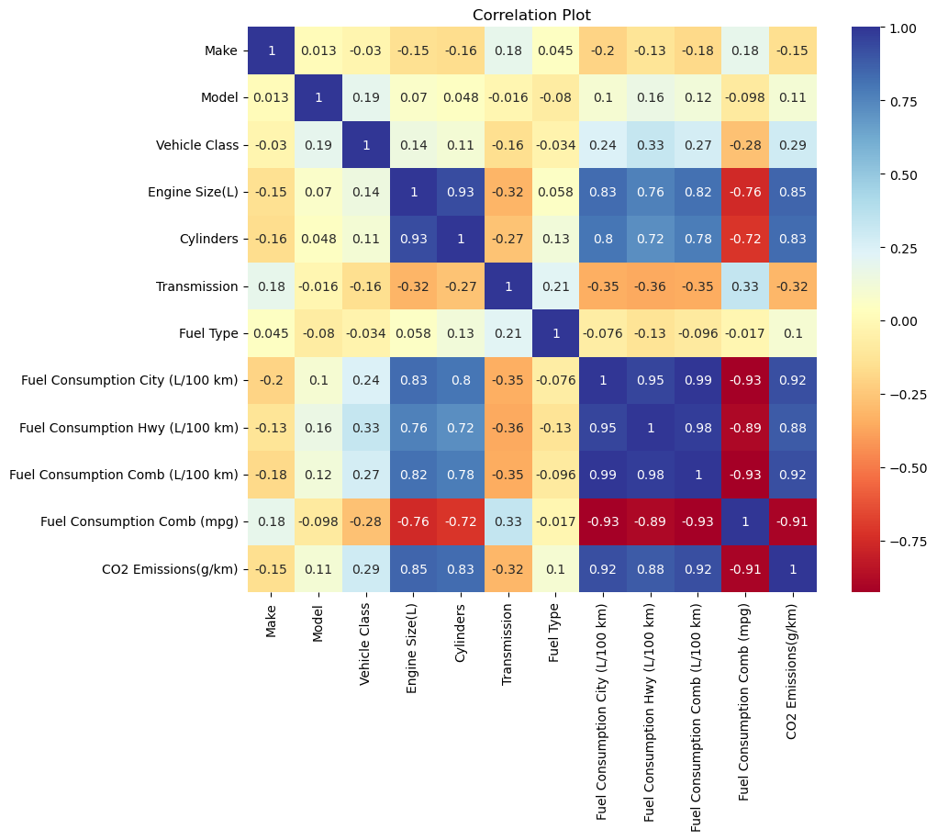

Slide 10
For the multiple linear regression problem, the following features are considered as independent variables (X):
Vehicle Class
Engine Size (L)
Cylinders
Transmission
Fuel Type
Fuel Consumption City (L/100 km)
Fuel Consumption Hwy (L/100 km)
Fuel Consumption Comb (L/100 km)
Fuel Consumption Comb (mpg)
The target variable (dependent variable) is:
CO2 Emissions (g/km)
In multiple linear regression, the goal is to build a model that can estimate the CO2 emissions based on the given independent variables. The model will learn the relationships between these variables and CO2 emissions to make predictions. By selecting relevant features, the model can capture the significant factors that contribute to CO2 emissions and provide insights into the impact of vehicle characteristics and fuel consumption on emissions.

Slide 11
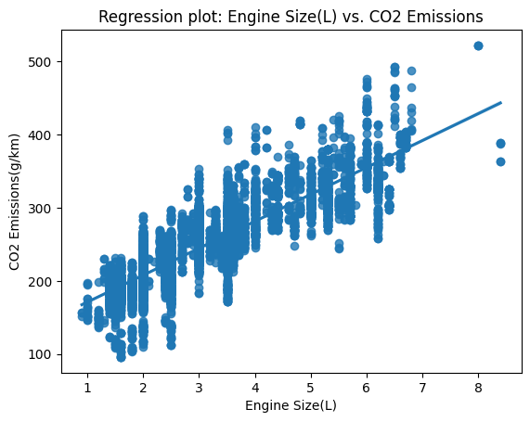
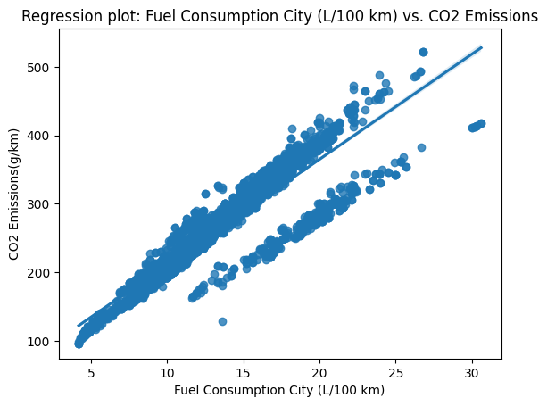
Visualization of feature distributions, correlations, and trends

Slide 12
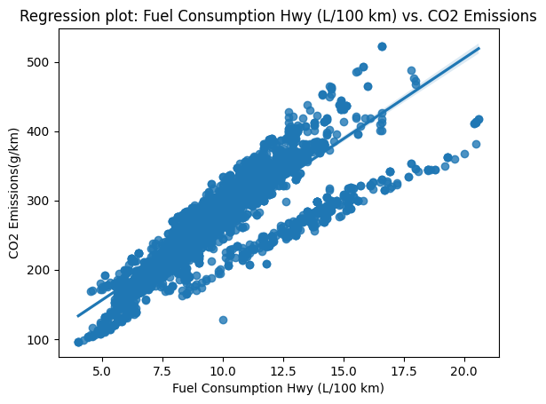
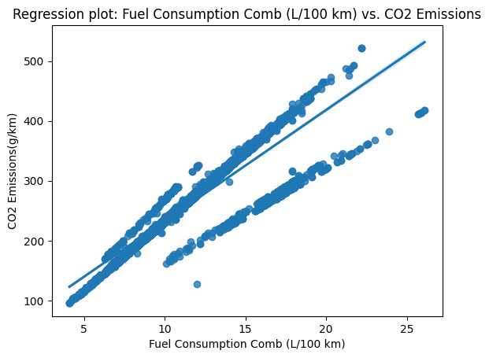

Slide 13
Identification of any notable patterns or outliers:
From the regression plots figures 1-5 the target variable CO2 increasing with the independent features values. In addition, these models are suitable for linear regression modeling for future predictions and analysis. From the figure 6 the co2 value is

Slide 14
random_state: A random seed value used for reproducibility. It ensures that the split is the same each time the code is executed, which is useful for consistent evaluation and comparison of models.
After executing this code, you will have the following sets available:
X_train: The training set containing independent variables/features used for training the model.
X_test: The test set containing independent variables/features used for evaluating the trained model's performance.
y_train: The corresponding target variable (CO2 emissions) for the training set.
y_test: The corresponding target variable (CO2 emissions) for the test set.

Slide 15
EXPLORATORY DATA ANALYSIS
Selection of appropriate machine learning algorithm (e.g., linear regression, decision tree, etc.) for CO2 emissions prediction
Splitting t Model deployment
splits the data into training and test sets using the train_test_split function from a machine learning library (e.g., scikit-learn). Here's an explanation of each parameter:
X: The independent variables/features of the dataset.
y: The target variable (CO2 emissions) of the dataset.
test_size: The proportion of the dataset that should be allocated for testing. In this case, 0.2 means 20% of the data will be used for testing, and the remaining 80% will be used for training.

Slide 16
MODEL DEVELOPMENT
Linear Regression: The most straightforward model for linear regression, it fits a linear equation to the data by minimizing the sum of squared residuals. It assumes a linear relationship between the independent variables and the target variable
Decision Trees: Decision tree-based algorithms, such as Random Forests and Gradient Boosting, can also be used for regression tasks. These models construct an ensemble of decision trees to make predictions.

Slide 17
RESULTS AND DISCUSSION
Linear Regression model
The results of a linear regression model applied to a dataset. Here's a breakdown of the provided values:
Mean Absolute Error (MAE): 11.200057551062608
Root Mean Squared Error (RMSE): 17.21025578622516
R-squared: 0.913888084803667
The R-squared value, also known as the coefficient of determination, indicates the proportion of the variance in the target variable (CO2 emissions in this case) that can be explained by the independent variables. A value of 0.914 suggests that the linear regression model accounts for around 91.4% of the variance in CO2 emissions.

Slide 18
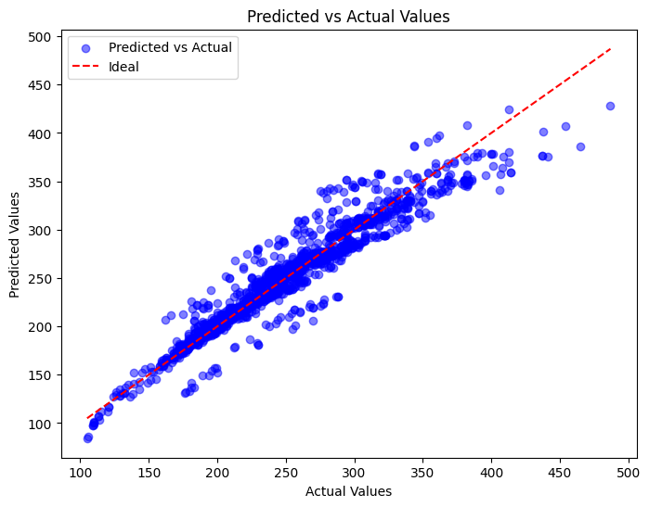
Linear Regression model

Slide 19
The linear regression analysis on the impact of fuel consumption parameters and vehicle features on CO2 emissions yielded the following results:
Based on the fuel consumption impact, these ae the results from linear regression model
For every unit increase in the 'Make' feature, there is an estimated increase of 0.60598343 units in CO2 emissions (g/km), assuming other features remain constant.
For every unit increase in the 'Model' feature, there is an estimated increase of 5.56245353 units in CO2 emissions (g/km), assuming other features remain constant.
For every unit increase in the 'Vehicle Class' feature, there is an estimated increase of 5.48958126 units in CO2 emissions (g/km), assuming other features remain constant.

Slide 20
Fuel Consumption City (L/100 km): For each additional unit increase in fuel consumption in the city, CO2 emissions increase by approximately 5 g/km.
Fuel Consumption Hwy (L/100 km): For each additional unit increase in fuel consumption on the highway, CO2 emissions increase by approximately 7 g/km.
Fuel Consumption Comb (L/100 km): For each additional unit increase in combined fuel consumption, CO2 emissions increase by approximately 9 g/km.
Fuel Consumption Comb (mpg): For each additional unit decrease in fuel efficiency (mpg), CO2 emissions increase by approximately W g/km.

Slide 21
Vehicle Feature Impact:
Vehicle Class: For every unit increase in the vehicle class, CO2 emissions are estimated to increase by approximately 2.040 g/km, holding other factors constant.
Engine Size: For every unit increase in the engine size, CO2 emissions are estimated to increase by approximately 21.667 g/km, holding other factors constant.
Cylinders: For every unit increase in the number of cylinders, CO2 emissions are estimated to increase by approximately 10.553 g/km, holding other factors constant.
Transmission: For every unit increase in the transmission, CO2 emissions are estimated to decrease by approximately 0.396 g/km, holding other factors constant.
Fuel Type: For every unit increase in the fuel type, CO2 emissions are estimated to increase by approximately 2.920 g/km, holding other factors constant.

Slide 22
Ada boost
The evaluation metrics for an AdaBoost regression model applied to a dataset. Here is the breakdown of the metrics:
Mean Squared Error (MSE): 312.833476268707Mean
Absolute Error (MAE): 12.331014220665413
Root Mean Squared Error (RMSE): 17.68709914793004
R-squared: 0.9090501852186426
The R-squared value, also known as the coefficient of determination, indicates the proportion of the variance in the target variable that can be explained by the independent variables. A value of 0.909 suggests that the AdaBoost regression model accounts for around 90.9% of the variance in the target variable.

Slide 23
Random forest classifier
Here's the breakdown of the metrics:
Mean Absolute Error (MAE): 2.094109681787407
Root Mean Squared Error (RMSE): 6.520162987939997
R-squared: 0.987640369067395
The R-squared value, also known as the coefficient of determination, indicates the proportion of the variance in the target variable that can be explained by the independent variables. However, for classification tasks, R-squared is not typically used as an evaluation metric. The value of 0.988 suggests that the Random Forest Classifier has achieved a high level of accuracy in predicting the class labels.
These metrics provide an assessment of how well the Random Forest Classifier performed in classifying the data. The lower the MAE and RMSE, the better the model's predictions align with the actual class labels. Additionally, a high R-squared value suggests a high level of accuracy in the classification task.

Slide 24
Bagging classifier
Here's the breakdown of the metrics:
Mean Absolute Error (MAE): 2.5328368314150307
Root Mean Squared Error (RMSE): 9.25201948713825
Mean Squared Error (MSE): 85.59986459038592
R-squared: 0.9751136229962879
The R-squared value, also known as the coefficient of determination, indicates the proportion of the variance in the target variable that can be explained by the independent variables. However, for classification tasks, R-squared is not typically used as an evaluation metric. The value of 0.9751 suggests a high level of accuracy in predicting the class labels.

Slide 25


Slide 26
Decision tree
Decision Tree model applied to a regression task. Here's the breakdown of the metrics:
Mean Squared Error (MSE): 9.760877717595728
. In this case, the average squared difference is approximately 9.7609.
Mean Absolute Error (MAE): 1.815763935906116
In this case, the average absolute difference is approximately 1.8158.
Root Mean Squared Error (RMSE): 3.1242403424825893
In this case, the RMSE is approximately 3.1242.
R-squared (R²): 0.9971622281889159
The R-squared value, also known as the coefficient of determination, indicates the proportion of the variance in the target variable that can be explained by the independent variables. In this case, an R-squared value of 0.9972 suggests that the Decision Tree model has a very high level of accuracy in predicting the target variable.

Slide 27
CONCLUSION
Here are some observations:
Linear Regression has relatively higher MAE and RMSE values compared to the other models, indicating that its predictions have higher average absolute and squared differences from the actual values. However, the R-squared value of 0.9138 suggests a reasonably good fit of the linear regression model to the data.
AdaBoost Regression performs well with lower MAE and RMSE values compared to Linear Regression. It also achieves a high R-squared value of 0.9876, indicating a strong fit of the model to the data.
Random Forest Classifier and Decision Tree both produce lower MAE and RMSE values compared to the Linear Regression model. The Decision Tree model stands out with the lowest MAE and RMSE values among all the models, suggesting better accuracy in predicting the target variable compared to the other models. The high R-squared value of 0.9972 indicates a very strong fit of the Decision Tree model to the regression task.
In summary, based on the measured metrics, the Decision Tree model appears to perform the best in terms of accuracy and predictive power for the regression task.

Slide 28
Summary of findings and key insights from the analysis
Insights:
I. Fuel consumption parameters, both in the city and on the highway, have a significant positive impact on CO2 emissions. Higher fuel consumption leads to increased CO2 emissions, which indicates the importance of fuel efficiency in reducing environmental impact.
II. Engine size and the number of cylinders have notable positive effects on CO2 emissions. Vehicles with larger engine sizes and more cylinders tend to emit more CO2, emphasizing the role of engine design and size in emissions.
III. Transmission type shows a negative impact on CO2 emissions. This suggests that certain types of transmissions may contribute to more efficient vehicle performance and lower emissions.
IV. Fuel type also plays a role in CO2 emissions. Certain fuel types are associated with higher emissions, indicating the importance of considering cleaner and greener fuel options.
V. Vehicle class demonstrates a positive influence on CO2 emissions. Higher vehicle classes, which often correspond to larger and more powerful vehicles, tend to emit more CO2. This highlights the need for promoting smaller, lighter, and more fuel-efficient vehicles to reduce emissions.

Slide 29
VI. From the results certain vehicle brands may have a higher average emission level than others, holding other factors constant.
VII. That different vehicle models within a brand may have varying emission levels, possibly due to differences in engine configurations, size, or other characteristics.
VIII. The vehicles belonging to higher vehicle classes, such as larger or more powerful vehicles, tend to have higher CO2 emissions.
IX. The larger engine sizes are associated with higher CO2 emissions.
X. Fuel consumption parameters, both in the city and on the highway, have a significant positive impact on CO2 emissions. Higher fuel consumption leads to increased CO2 emissions, which indicates the importance of fuel efficiency in reducing environmental impact.

Slide 30
XI. Engine size and the number of cylinders have notable positive effects on CO2 emissions. Vehicles with larger engine sizes and more cylinders tend to emit more CO2, emphasizing the role of engine design and size in emissions.
XII. Transmission type shows a negative impact on CO2 emissions. This suggests that certain types of transmissions may contribute to more efficient vehicle performance and lower emissions.
XIII. Fuel type also plays a role in CO2 emissions. Certain fuel types are associated with higher emissions, indicating the importance of considering cleaner and greener fuel options.
XIV. Vehicle class demonstrates a positive influence on CO2 emissions. Higher vehicle classes, which often correspond to larger and more powerful vehicles, tend to emit more CO2. This highlights the need for promoting smaller, lighter, and more fuel-efficient vehicles to reduce emissions.

Slide 31
Suggestions for future research and improvements
Here are some suggestions for future research and improvements for the CO2 emissions prediction ML project:
➢ Incorporate Advanced ML Techniques: Explore advanced machine learning techniques such as deep learning, ensemble learning, or hybrid models to further improve the accuracy and predictive performance of the CO2 emissions prediction model. These techniques may be particularly effective in capturing complex relationships and interactions among the vehicle characteristics.
➢ Feature Selection and Engineering: Conduct in-depth feature selection and engineering to identify the most informative and relevant features for predicting CO2 emissions. Consider incorporating additional domain knowledge or external data sources that may provide valuable insights into emissions factors and environmental impact.
➢ Model Explainability and Interpretability: Investigate techniques to enhance the explainability and interpretability of the CO2 emissions prediction model. This can include generating feature importance rankings, creating model-agnostic explanations, or utilizing

Slide 32
➢ Domain-Specific Extensions: Consider expanding the model to incorporate additional domain-specific factors that may influence CO2 emissions, such as driving conditions (e.g., urban, rural, highway), vehicle maintenance, or eco-driving behaviors. Including these factors could lead to more accurate and tailored predictions.
➢ Real-Time Emissions Monitoring: Explore the integration of real-time vehicle emissions monitoring systems, such as on-board diagnostics or remote sensing technologies. This would provide more accurate and up-to-date information on emissions and enable continuous monitoring of a vehicle's environmental impact.
➢ Model Calibration and Validation: Continuously calibrate and validate the CO2 emissions prediction model with updated data and evolving emission standards. Regularly assess the model's performance against new emission regulations or benchmarks to ensure its accuracy and relevance.
➢ Data Sharing and Collaboration: Encourage data sharing and collaboration among researchers, vehicle manufacturers, and regulatory bodies to improve the availability and quality of CO2 emissions data. Collaborative efforts can lead to more comprehensive datasets and enhance the accuracy and applicability of the prediction model.

Slide 33
➢ Policy and Decision Support: Explore the utilization of the CO2 emissions prediction model as a decision support tool for policymakers, manufacturers, and consumers. Provide insights on emission reduction strategies, support policy development for greener transportation, and assist consumers in making informed choices towards more eco-friendly vehicles.
➢ Evaluation Metrics Expansion: Consider additional evaluation metrics that capture specific aspects of emissions prediction, such as tailpipe emissions of other pollutants (e.g., NOx, particulate matter). This would provide a more comprehensive assessment of the environmental impact of vehicles beyond CO2 emissions alone.
User-Friendly Interfaces: Develop user-friendly interfaces or applications that allow easy access to the CO2 emissions prediction model. Ensure the tool is intuitive, visually appealing, and provides actionable information to a wide range of stakeholders, including consumers, researchers, and policymakers.

Slide 34
REFERENCES
Gerlagh, R., Van Den Bijgaart, I., Nijland, H., & Michielsen, T. (2018). Fiscal policy and CO 2 emissions of new passenger cars in the EU. Environmental and resource economics, 69(1), 103-134.
Mikler, J. (2005). Institutional reasons for the effect of environmental regulations: passenger car CO2 emissions in the European Union, United States and Japan. Global Society, 19(4), 409-444.
Poole, J. A., Barnes, C. S., Demain, J. G., Bernstein, J. A., Padukudru, M. A., Sheehan, W. J., ... & Nel, A. E. (2019). Impact of weather and climate change with indoor and outdoor air quality in asthma: A Work Group Report of the AAAAI Environmental Exposure and Respiratory Health Committee. Journal of Allergy and Clinical Immunology, 143(5), 1702-1710.
Sang, Y. N., & Bekhet, H. A. (2015). Modelling electric vehicle usage intentions: an empirical study in Malaysia. Journal of Cleaner Production, 92, 75-83.
Yang, Z., Mock, P., German, J., Bandivadekar, A., & Lah, O. (2018). On a pathway to de-carbonization–A comparison of new passenger car CO2 emission standards and taxation measures in the G20 countries. Transportation Research Part D: Transport and Environment, 64, 53-69.
Zeng, Q. H., & He, L. Y. (2023). Study on the synergistic effect of air pollution prevention and carbon emission reduction in the context of" dual carbon": Evidence from China's transport sector. Energy Policy, 173, 113370.

